Slide 1
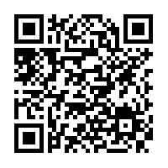

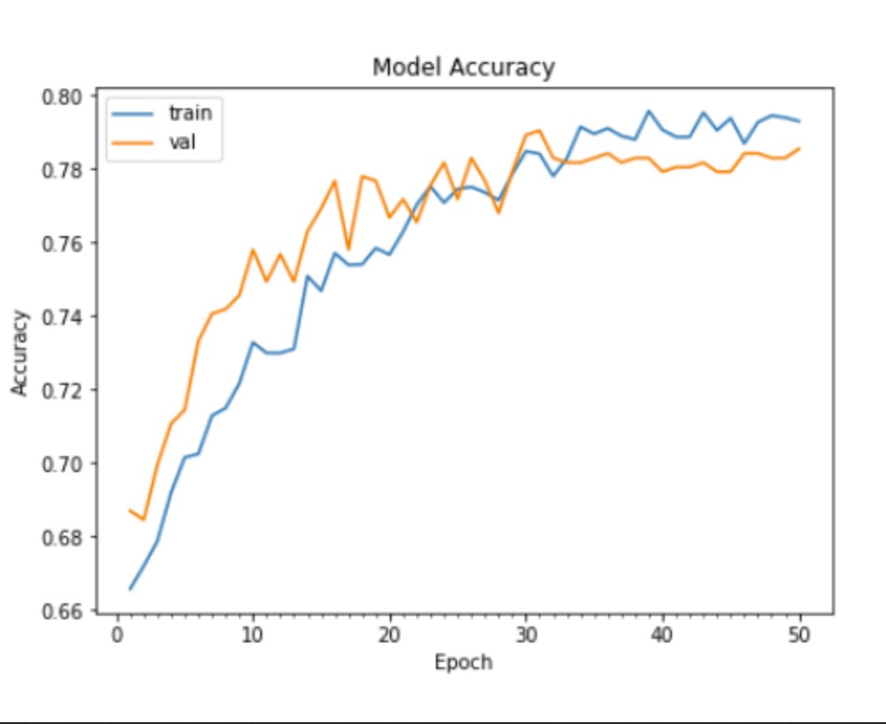
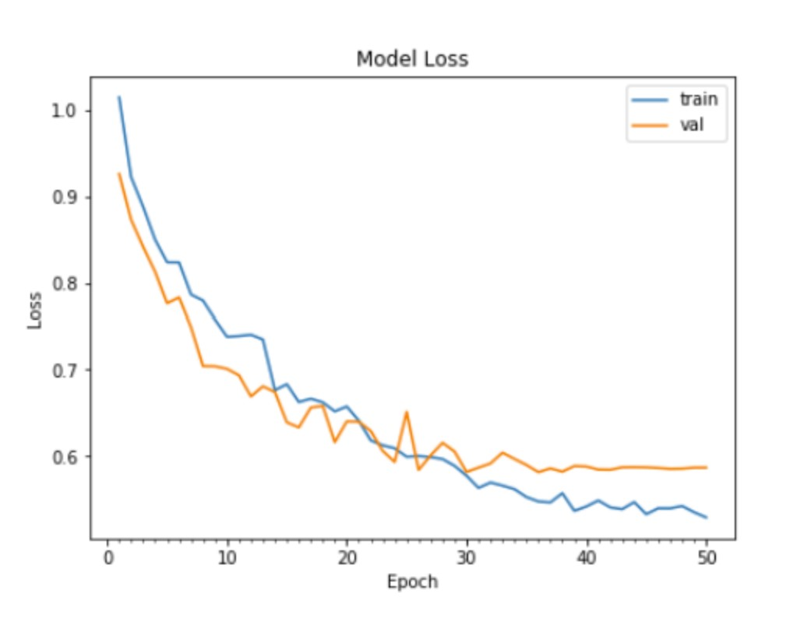
Exploring the Combination of Machine Learning and Nanotechnology in Skin Cancer Detection
Christopher D. Huynh, David Shi, Jerry Zhu
Product mission:
Our Model:
Discussion:
Delay in cancer care results in higher costs and greater complexity of treatment. Early detection of cancer is critical for successful patient outcomes.
Our goal: To contribute to cancer research by combining machine learning with nanotechnology to create a new model for early diagnosis of cancer.
Image-based classifier for skin cancer detection.
Convolutional Neural Network (CNN) Architecture:
Keras Sequential API: Able to add one layer at a time.
Optimizer: Adam
Able to produce machine learning model for skin cancer detection with approximately 78% accuracy.
Carbon nanotubes are versatile for cancer detection due to their properties.
Results | Challenges
Able to detect skin cancer with machine learning model. | Given time constraints, model could not be trained with generated nanotechnology signals.
Better understanding of how nanotechnology is used within cancer detection. | Lack of relevant nanotechnology data for signal generation given the scope of the project.
Optimize machine learning model given time constraints.
Conv2D
MaxPool2D
Methodology:
Flatten
Dense
Dropout
Literature review of existing cancer detection methods.
Analyze nanotechnology used within cancer research.
Select type of cancer for study (skin cancer).
Train initial machine learning model for cancer identification using existing datasets.
Incorporate nanotechnology signals into a machine learning model.
ReLU
Dropout
Nanotechnology:
Carbon nanotubes focus.
Literature review on skin cancer biomarkers.
Examination of skin cancer detection using carbon nanotubes (biomarker focus).
Generation of synthetic nanotechnology signals for model training.
Moving Forward:
Work on signal generation for existing model.
Based upon our current model, expand to detect other types of cancer.
Model can interpret a wide variety of signals from different pieces of nanotechnology.
Design user-friendly interface.

